Slide 1
Rajalakshmi Engineering College
An Autonomous Institution
Chennai-602105

Slide 2



FACULTY PROFILE
Mrs. D Sorna Shanthi
Associate Professor
Department of Computer Science and Engineering
9841549254
sornashanthi.d@rajalakshmi.edu.in

Slide 3



EXPECTATIONS

Slide 4

INSTRUCTIONS
Separate Class work note
Syllabus to be pasted in front page
Course Objectives and Outcomes to be pasted in second page

Slide 5
INSTRUCTIONS
Take proper running notes during class hours.

Slide 6

INSTRUCTIONS
INSTRUCTIONS
Interaction-Participation

Slide 7
SYLLABUS-THEORY
SYLLABUS-THEORY
UNIT-I | INTRODUCTION AND ANALYSIS OF ALGORITHMS |  |  | 9
Introduction –Algorithm Specification –Important Problem types- Performance Analysis: Space Complexity - Time Complexity - Asymptotic Notations - Using Limits for Comparing Orders of Growth – Basic Efficiency Classes- Solving Recurrence Relations: Substitution methods and Master Theorem Method
UNIT-II | BRUTE FORCE AND DIVIDE-AND-CONQUER |  |  | 9
Brute Force: Exhaustive Search - Travelling Salesman Problem - Knapsack Problem - Assignment problem - Divide and Conquer Method: Analysis of Binary Search, Merge sort and Quick sort Algorithms, Integer Multiplication-Finding Minimum and Maximum.
UNIT-III | GREEDY TECHNIQUE AND DYNAMIC PROGRAMMING |  |  | 9
Greedy Method – Minimum Spanning Trees: Kruskals Algorithm– Fractional Knapsack - Huffman Codes - Dynamic Programming: General Method - String Editing - 0/1 Knapsack - Travelling Salesman Problem.
UNIT-IV | BACKTRACKING AND BRANCH & BOUND |  |  | 9
Backtracking: General Method - 8 Queen's Problem - Sum of Subsets Problem - Graph Colouring - Hamiltonian Circuit Problem - Branch and Bound: LC branch and bound - 0/1 Knapsack - Travelling Salesman Problem.
UNIT-V | STRING MATCHING AND NP COMPLETE & NP HARD |  |  | 9
String Matching: Naive String Matching - Rabin Karp - Knuth Morris Pratt - NP Complete and NP Hard Problems: Basic Concepts - Non Deterministic Algorithms - Class of NP Complete and NP Hard – Approximation Algorithms :: Travelling Salesman problem.
 |  | Contact Hours | : | 45

Slide 8
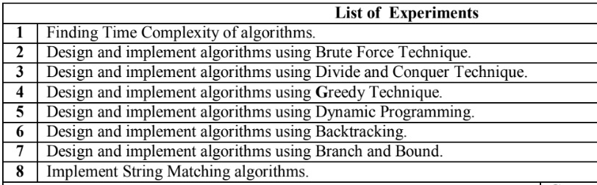
SYLLABUS-LAB

Slide 9
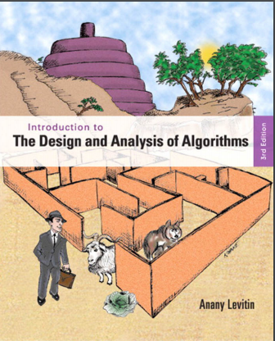
TEXT BOOK 1
Anany Levitin, “Introduction to the Design and Analysis of Algorithms”, Third Edition, Pearson Education, 2012

Slide 10

Ellis Horowitz, Shani, Sanguthevar Rajasekaran, "Computer Algorithms" Universities Press, Second Edition 2008.
TEXT BOOK 1

Slide 11



COURSE-WHAT-YOU LEARN
ANALYSIS
DESIGN
HOW?
CREATE
EFFECIENCY
EFFECIENT
METHODS
STRATEGIES

Slide 12
COURSE OUTCOMES
On completion of the course, the students will be able to
● | Analyze the time and space complexity of various algorithms and compare algorithms with respect to complexities.
● | Ability to decide and Apply Brute Force and Divide and Conquer design strategies to Synthesize algorithms for appropriate computing problems.
● | Ability to decide and Apply Greedy and Dynamic Programming techniques to Synthesize algorithms for appropriate computing problems.
● | Ability to decide and Apply Backtracking and Branch and Bound techniques to Synthesize algorithms for appropriate computing problems.
● | Apply string matching algorithms in vital applications

Slide 13
UNIT – I-Topics
Introduction
Algorithm Specification
Important Problem types
Performance Analysis: Space Complexity - Time Complexity
Asymptotic Notations
Using Limits for Comparing Orders of Growth
Basic Efficiency Classes
Solving Recurrence Relations: Substitution methods and Master Theorem Method

Slide 14

ALGORITHM
An algorithm is a sequence of unambiguous instructions for solving a problem, i.e. for obtaining the required output for any legitimate input in a finite amount of time.
PROBLEM
ALGORITHM
INPUT
OUTPUT

Slide 15
CHARACTERISTICS OF AN ALGORITHM
Well Defined Inputs
Well Defined Outputs
Effectiveness
CRITERIA
Correctness
Finiteness
Clear-
Unambiguous

Slide 16





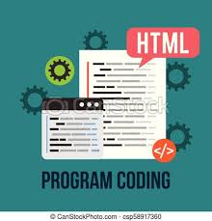
Fundamentals of Algorithmic Problem Solving
UNDERSTAND THE PROBLEM
DECIDE ON COMPUTATIONAL MEANS,EXACT OR APPROX SOLUTION ,ALGORITHM DESIGN TECQ.
DESIGN AN ALGORITHM
PROVE ITS CORRECTNESS
ANALYSE THE ALGORITHM
CODE THE ALGORITHM

Slide 17
Understanding the problem
Understand completely the given problem statement.
Ask questions if you have doubt.
An input to an algorithm specifies an instance of the problem the algorithm solves.
Fix the set of instances that the algorithm can handle.

Slide 18
Exact Vs Approximate Problem Solving
Exact Solution
Approximate Solution
Decide on Computational Means
Determine the Computational Means
Computational Device (Processor and Memory)
Sequential or Parallel algorithm
Algorithm Design
Technique
Strategy
Classic Problem
Statements –Practice Strategies/Approach

Slide 19
Design the Algorithm
Choosing Data Structures
Specifying an Algorithm
Natural Language
Pseudocode
Flowchart
Algorithms + Data Structures = “PROGRAMS”

Slide 20
Prove the Correctness
Algorithm works fine – Legitimate Input & Finite amount of time
Correctness – Approximation Algorithms Vs Exact Algorithms
Approximation Algorithm – error produced doesn’t exceed predefined limit

Slide 21
Analyze the Algorithm
Time Efficiency
Space Efficiency
Generality
Simplicity

Slide 22
Code the Algorithm
Identify the programming Language
Code It!!

Slide 23
Frame 5 Questions

Slide 24
Fill in the blanks

Slide 25


